Slide 1
Cost Management Techniques

Slide 2

Poll based on previous lecture
Raymond has the total recruitment cost for $50,000.
This is one of the important ‘activity’ while doing the production of garments.
Identify which of the following will serve as the most appropriate ‘cost driver’ for this activity?
Number of machine set – ups
Number of times orders placed
Number of personnel
Number of customers served
Notes:
b

Slide 3
Learning Outcomes
Appraise the various techniques of cost management.
Comprehend the importance of cost management techniques in reducing the costs of the business.

Slide 4
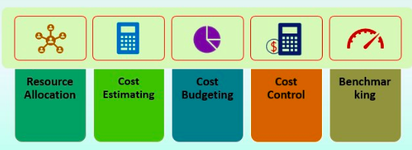
Cost Management
Process of estimating, allocating, and controlling product costs.
Allows a business to predict coming expenses in order to reduce the chances of budget overrun.

Slide 5
Cost Management Techniques
Target Costing
Life Cycle Costing
Value Analysis

Slide 6
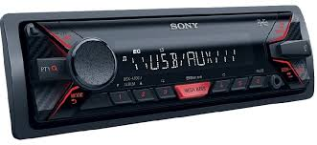
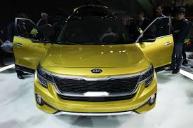
A.) Target Costing of ‘JBL’
Kia Motors, an automobile company approaches ‘JBL’ to manufacture the special set of music systems.
These music systems will be installed in the different car models of Kia Motors.
‘JBL’ reviews the similar music systems in the market in order to decide upon the selling price.
It will then chooses the profit it desires, and thus comes up with the a target cost.

Slide 7
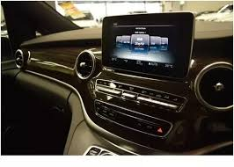
What JBL is doing?
Estimating the product cost (music system) based on competitive market price
Target Costing
JBL will manufacture music system with no cost structure in mind
Selling Price – Profit = Target Cost

Slide 8
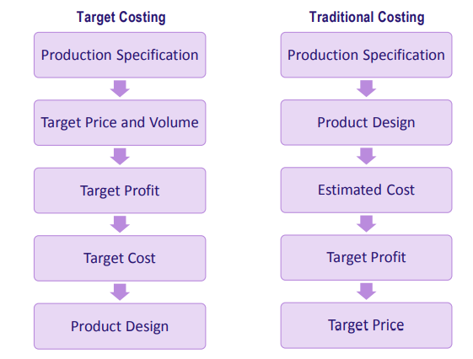
Target Costing Vs. Traditional Costing

Slide 9
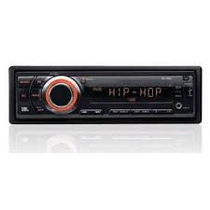
Poll
The following are steps in the implementation of the target costing process for a music system by JBL:
Calculate the target cost.
Calculate the estimated current cost based on the existing product specification.
Set the required profit.
Set the selling price.
Which of the following represents the correct sequence target costing were to be used?
(1), (2), (3), (4)
(2), (3), (4), (1)
(4), (3), (1), (2)
(3), (4), (1), (2)
Notes:
c

